Slide 1

Social Media Feed Analysis
Aditeya Baral
E L Mahima
Vinay Kirpalani

Slide 2
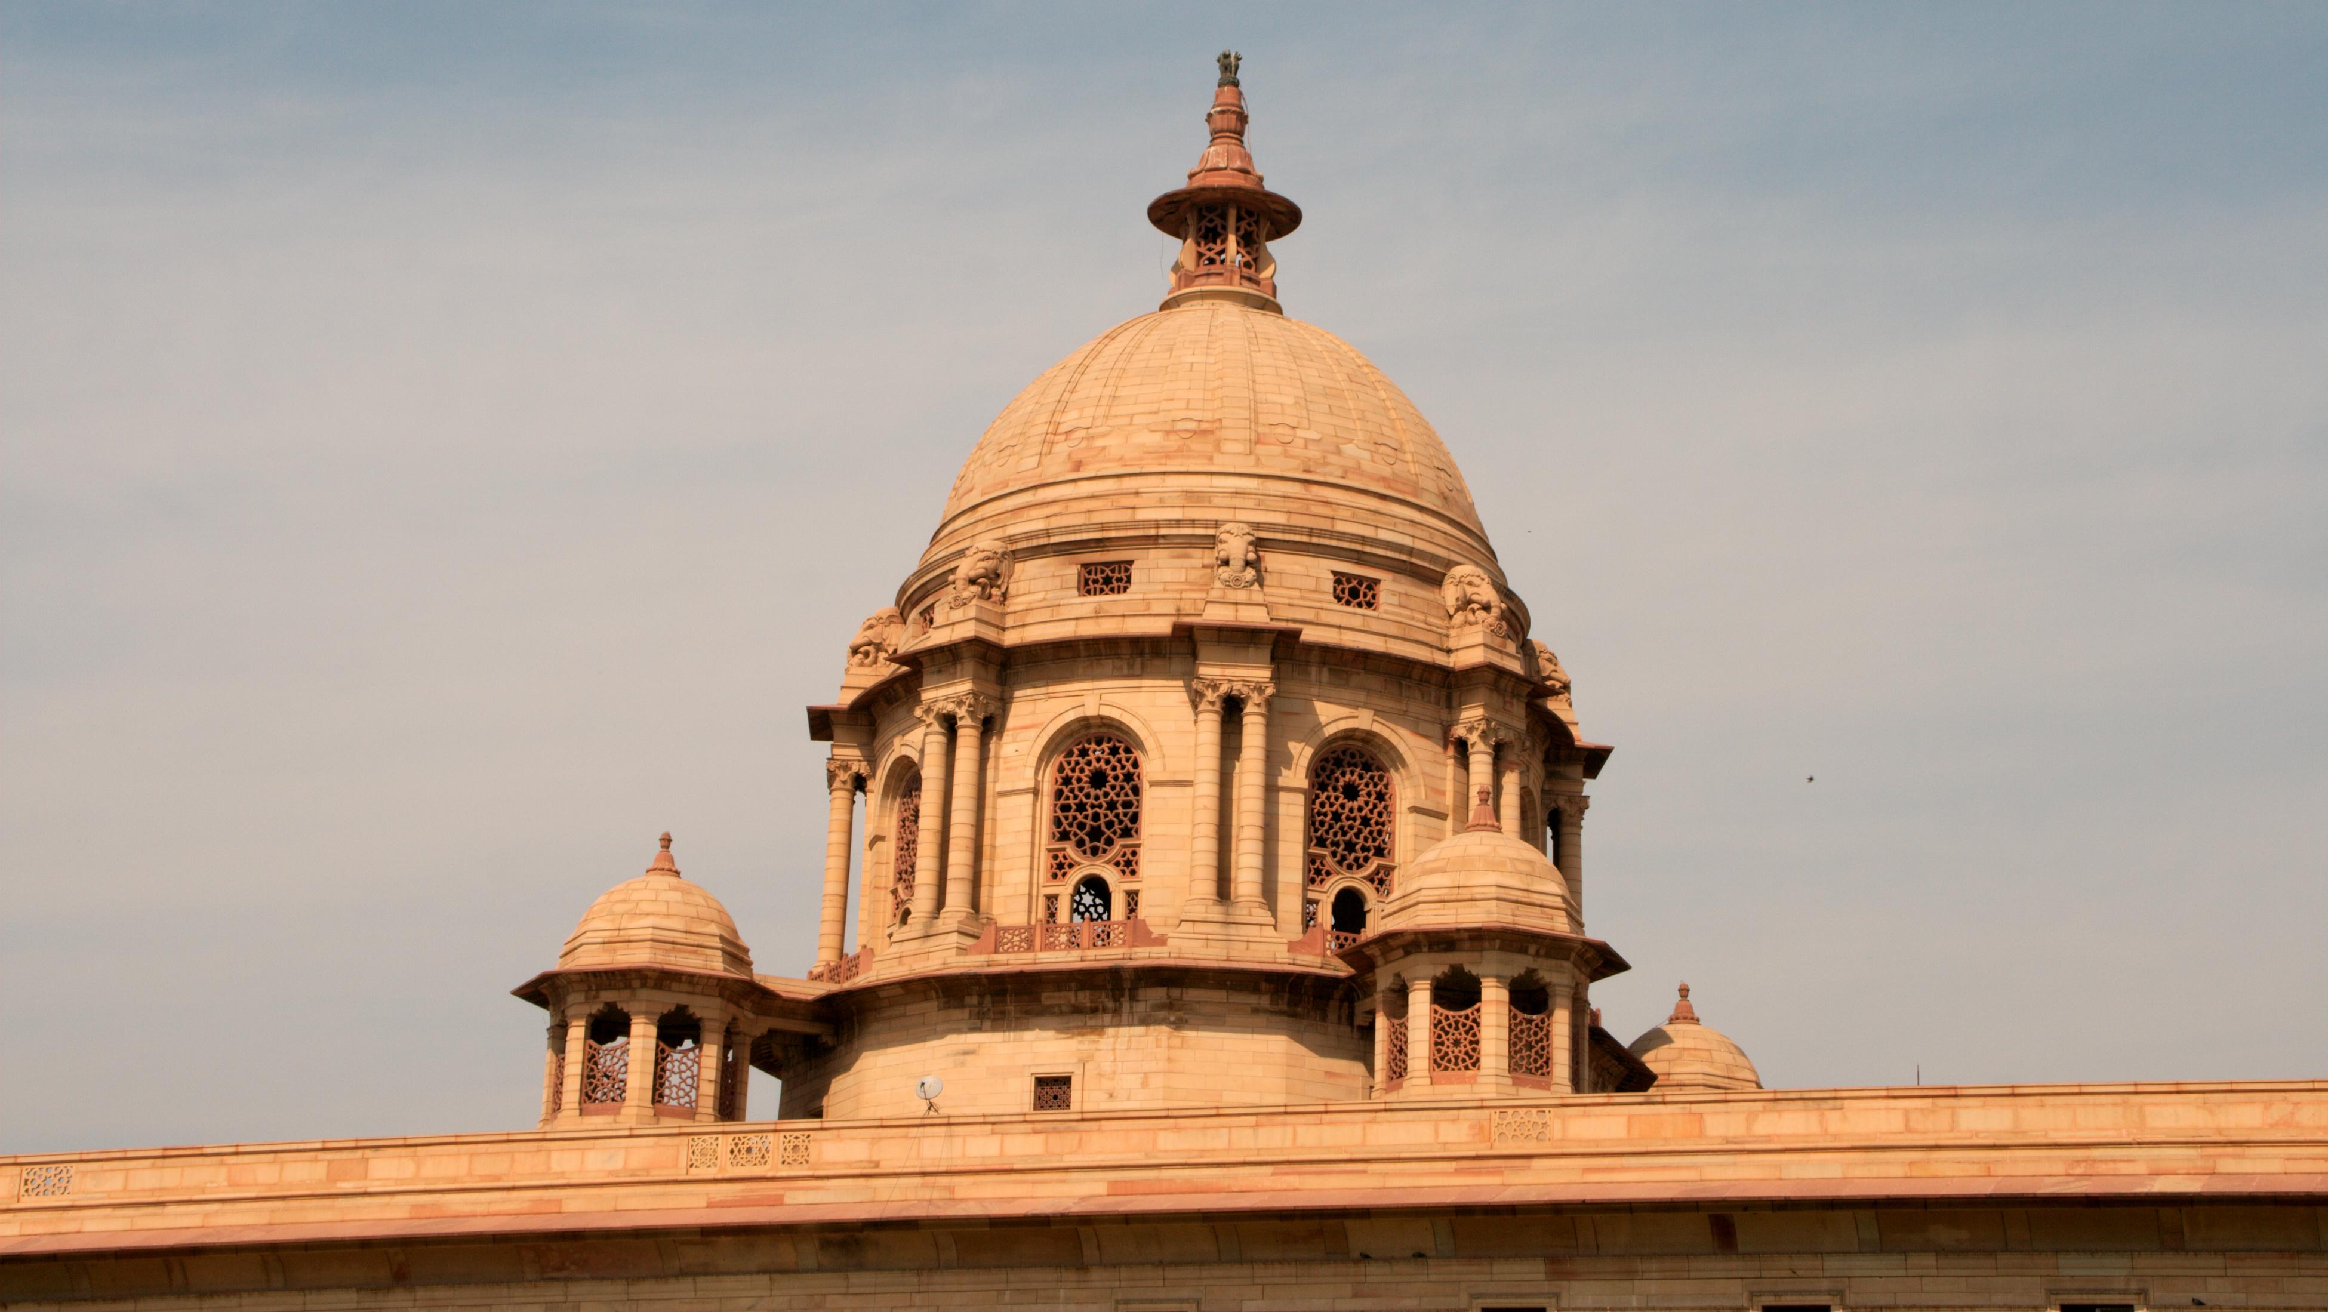
Introduction

Slide 3

Social Media
Social Media has brought us closer than even before and has provided a common platform for us to communicate with one another.
We live in a world where everyone is connected, in one way or another. Almost 4 billion people in the world are active on social media right now.
Every second, more than 6000 tweets are tweeted, more than a 100 thousand pictures liked on Instagram and much more.

Slide 4
Why Social Media?
Although Social Media has its downsides, we absolutely cannot deny the potential it holds in various domains. From businesses to even politics, social media plays a pivotal role.
An average person will post about 45% of their life on social media, thus making it easier for us to perform an in-depth analysis of the demographic based on their activity.
Social media analytics is the practice of gathering data from social media websites and analyzing that data using social media analytics tools to make decisions. The most common use of social media analytics is to mine customer sentiment.

Slide 5
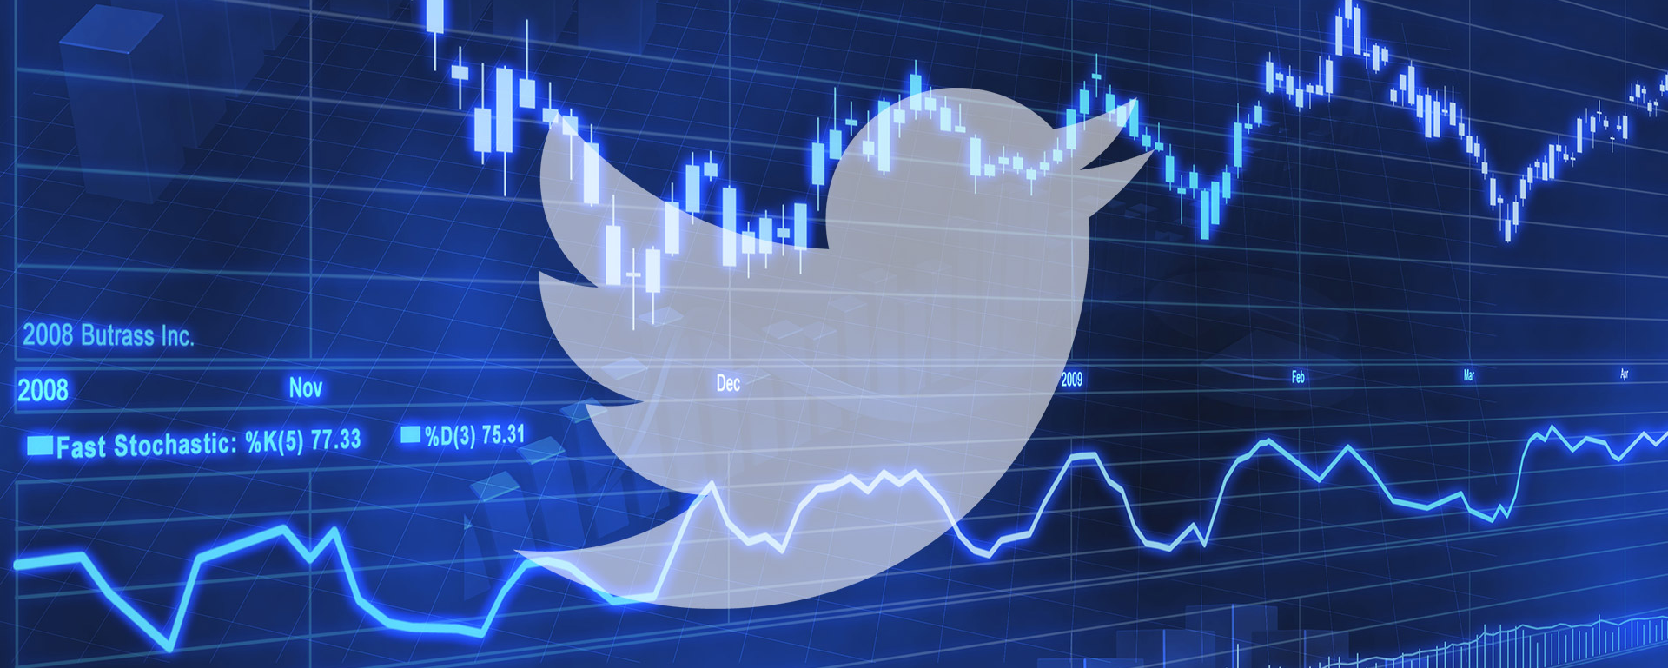
Twitter for Social Media Analytics

Slide 6
Twitter Feed Analysis
Twitter averages nearly 500 million tweets per day and more than 6000 per second!
It has more than 330 million active users, and 1/10th of them are Indians.
Twitter provides a valuable tool for social media analysis because it is a never-ending resource which is self sufficient and keeps along with the times.
It provides a platform to post any kind of media and with a total character length of 280, it provides us with enough material to analyse sentiment accurately.
Multiple social media platforms have been created and many of them have been discontinued but Twitter still rides strongly with its large following.

Slide 7
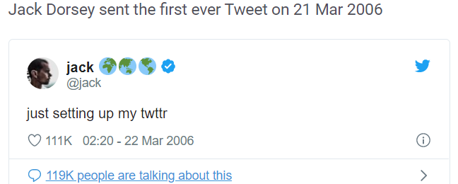
Twitter Grew from this

Slide 8

To this!?

Slide 9


Slide 10
What are we doing?
Almost 400 million tweets were made during the Lok Sabha Elections held in 2019. Tweets were made in English, Hindi as well as other languages.
Our project aims to analyse all the 23rd hour tweets made between March and May and draw conclusions based on social media activity.
We have gauged people’s thoughts and emotions on social media to predict the shift in support towards a party and compare the accuracy with actual poll results.

Slide 11

The Dataset

Slide 12
Features of the Election Dataset
We tried to build our own dataset, but this was impossible as the Twitter API did not support tweet extraction for those which are more than 2 weeks old.
The dataset used for this project is a subset of a much larger dataset from Kaggle. The reason for omitting a few columns is that they contained processed data based on other columns.
The final dataset used by us had 12 attributes and nearly 46000 rows.
The data had lots of noise and various inconsistencies which had to be cleaned.

Slide 13

Data Cleaning

Slide 14

How did we do it?
Removed US Congress Tweets and tweets made after results.
Replaced NaN values with default values.
Converted times to datetime objects and sorted the dataset.
Mapped missing cities and states and fixed name inconsistencies.
The final dataset had 39 thousand rows compared to the original 46 thousand.

Slide 15
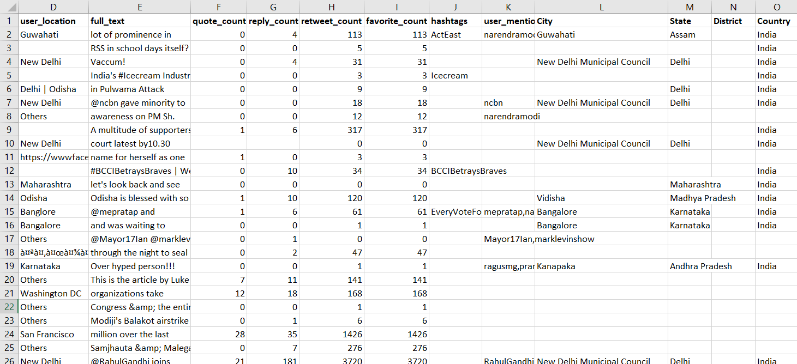
Comparison – Original Dataset

Slide 16
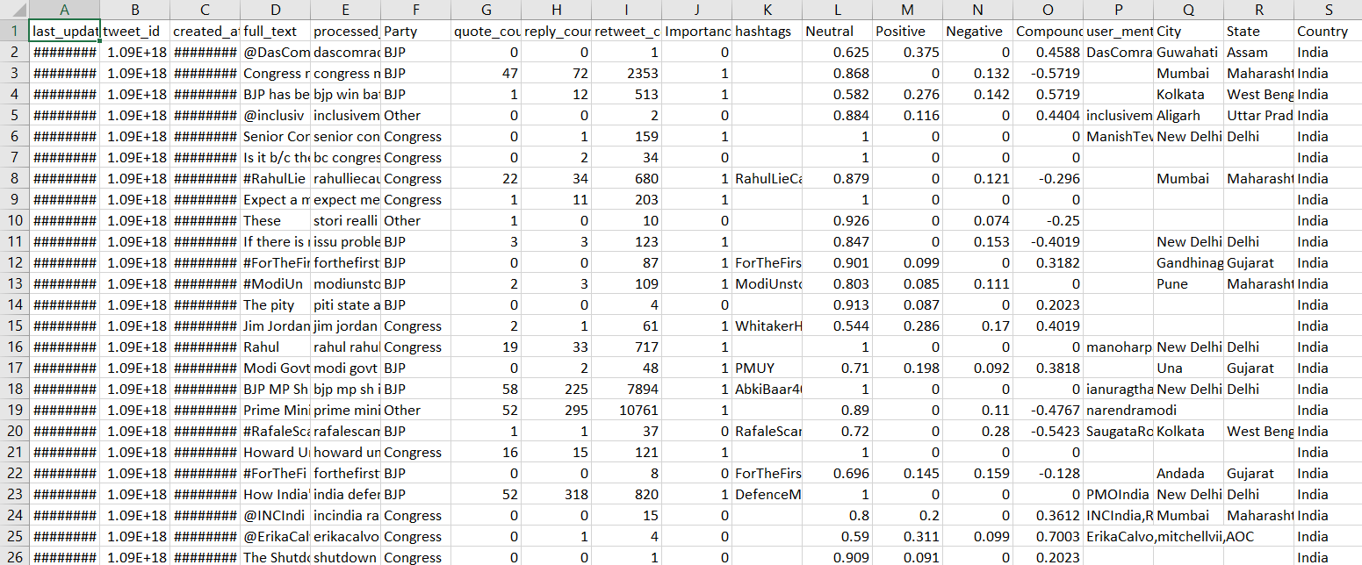
Final Dataset

Slide 17

Working with Data

Slide 18
Processing Dataset
We needed to clean the tweets before analyzing them.
The tweets were preprocessed
Each tweet was stripped of any kind of numbers, hashtags and emojis/symbols and all contracted words were expanded using RegEx.
The tweets were finally stemmed using the Snowball Stemmer
(Porter 2).

Slide 19
Analysing Sentiment and Importance
The polarity of tweets was measure using nltk’s sentiment analyser. Its positive, neutral, negative and compound scores were tabulated and stored.
The number of replies, retweets and quotes defined the importance of a tweet. After using the descriptive statistics to decide the cutoffs, the importance was stored as binary coded 2 states.

Slide 20
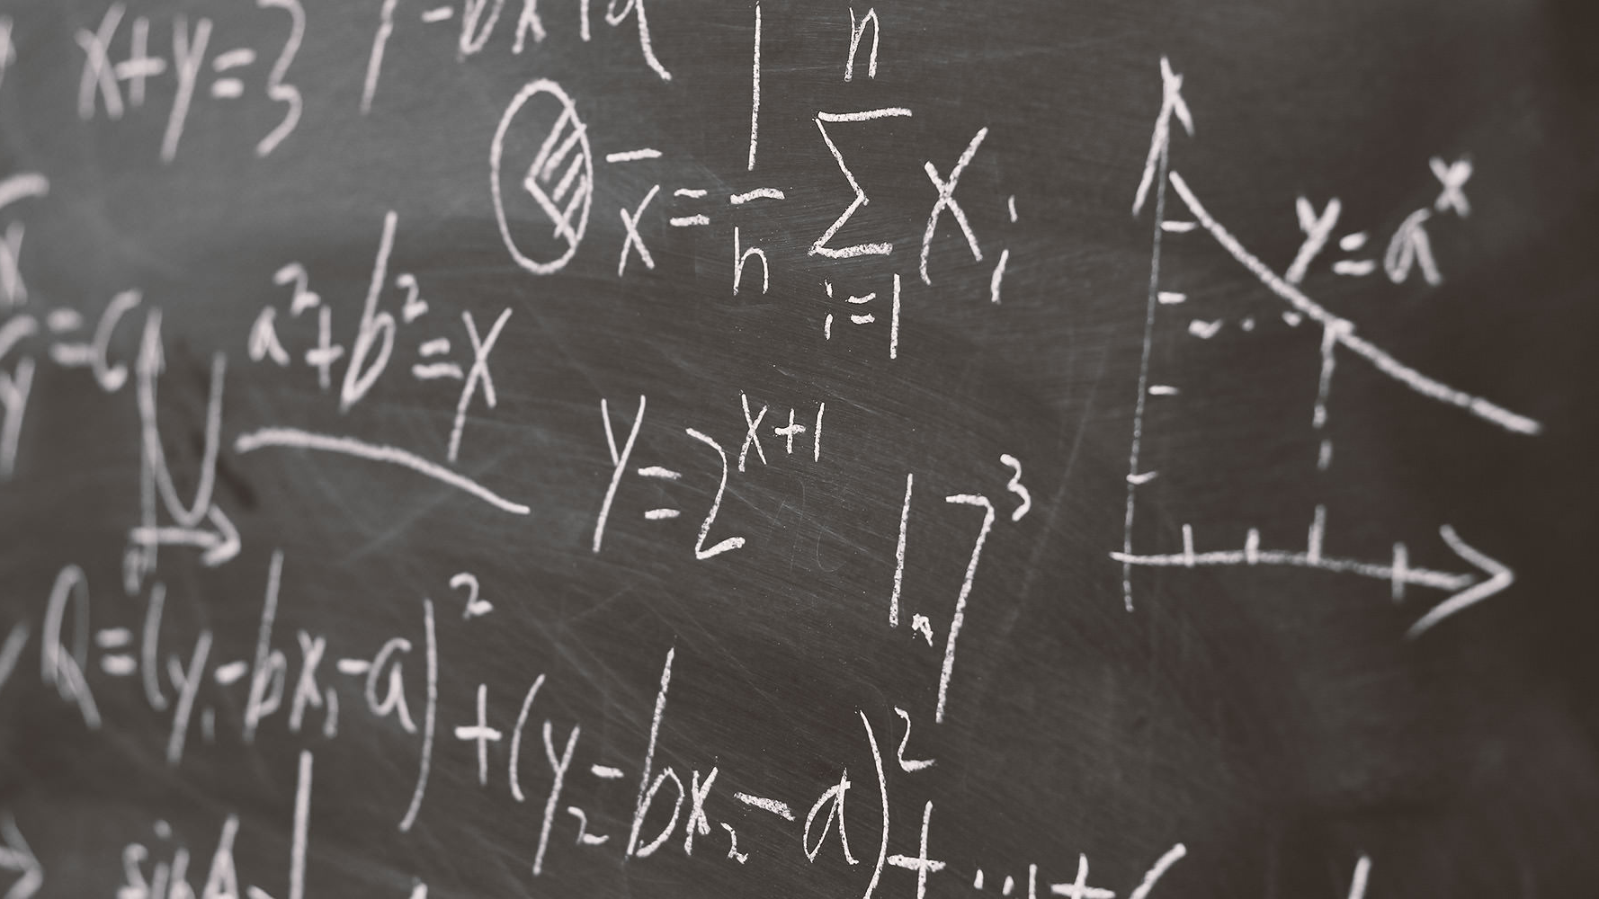
Scoring Tweets

Slide 21
Scoring Tweets
We assigned an overall score to every tweet.
This score accounted factors such as retweets, quotes, replies and the previously calculated importance.
We defined a simple linear homogenous function in terms of factors with coefficients equal to the correlation between them and the positive sentiment.
The final score hence gave a weighed popularity measure of the tweet which depended on the factors.

Slide 22
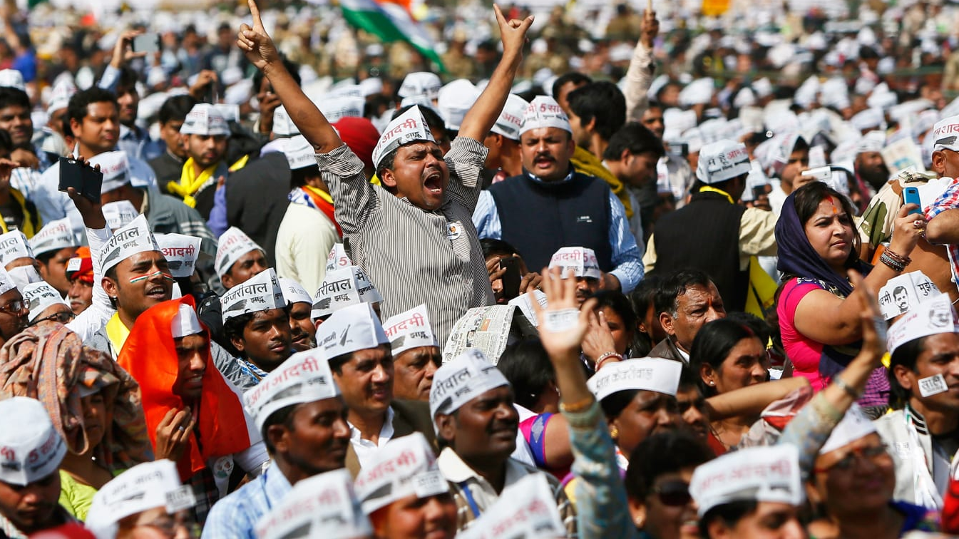
Classification into Parties

Slide 23
Classifying Tweets into Parties
Since there was no tagged dataset available, we couldn’t use any classification algorithm.
1
We hence went ahead with a simple frequency-based classification technique.
2
We distinguished between tweets by using the frequency of a set of terms related to different parties.
3
This method although slow, worked to a high degree of accuracy when manually checked
4

Slide 24
Party Distribution

Slide 25

Popularity

Slide 26
Popularity Scores
We obtained a regular time interval for days, weeks, fortnights and months.
We plotted the cumulative popularity for each party for against the time intervals. We found that the daily popularity score was the perfect scale.
We plotted the popularity of each party in the top 10 states and the final popularity index of each party.
The plots obtained are an accurate representation of the actual shift in popularities of each party throughout the interval.

Slide 27

Graphs and Visualizations

Slide 28

Socially Active Regions
We decided to find out which states tweeted the most during the General Elections.
This helped us analyse whether all states had an equal say in a party’s popularity.
We obtained the states that had atleast 150 tweets and plotted a bar graph.
However we were dissatisfied with the plot and felt that it could be made more interesting.

Slide 29
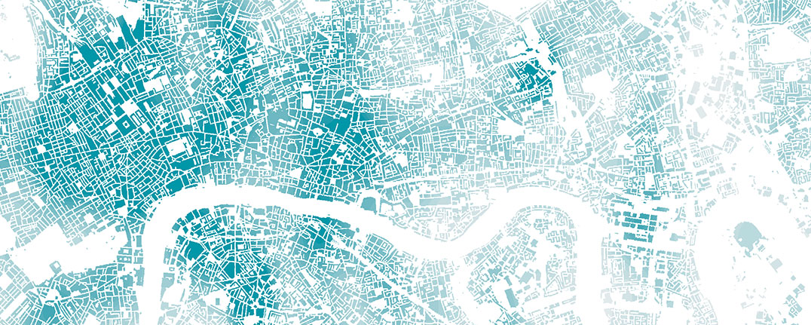
Geo Spatial Plots

Slide 30
Why Geo Spatial?
Since the data plotted consisted of regions, we felt that it could be better represented on spatial plot.
We decided to use a Geo-Spatial Choropleth plot for showing scores of different regions.
We obtained the India shapefile and converted each field in the dataframe to a geo dataframe using geopandas.
The states were then plotted by converting them into polygonal objects from the shapefile.
A value in the choropleth defines the depth of colour used, so darker shades represent higher values.

Slide 31
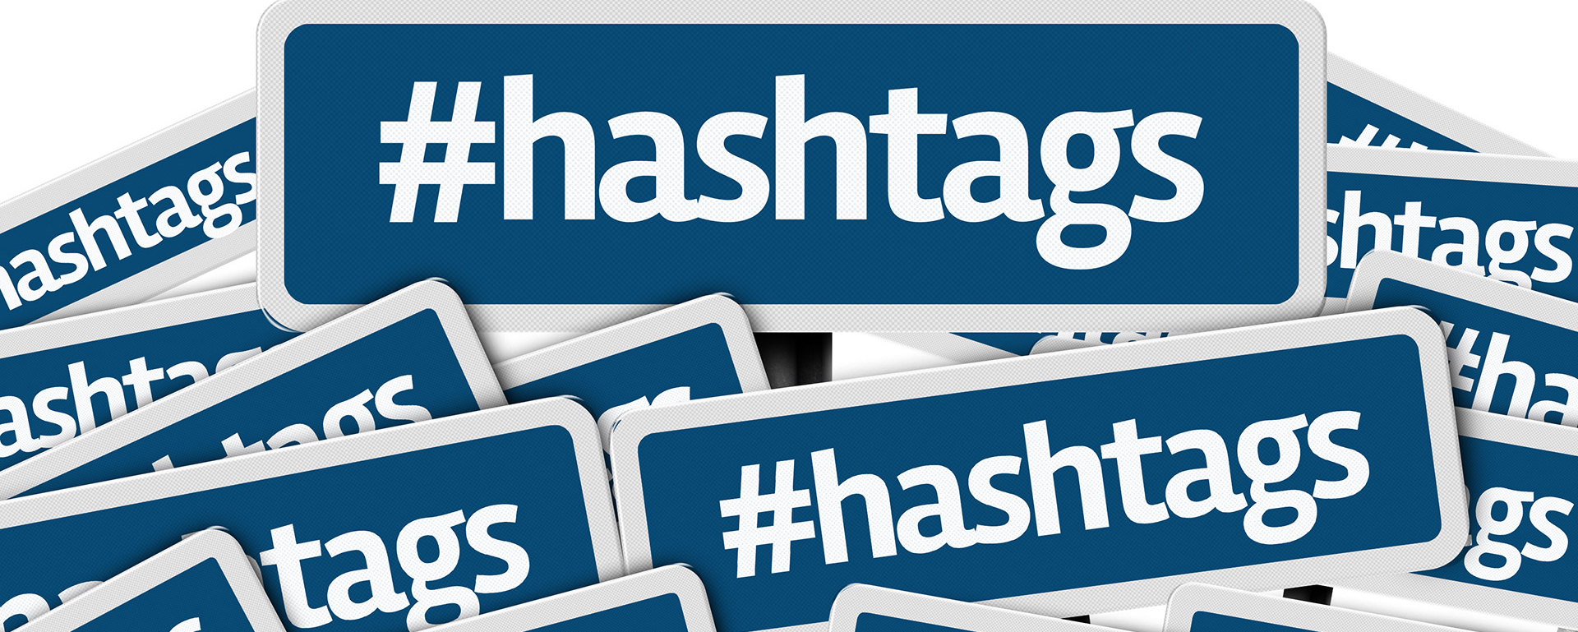
Hashtags

Slide 32
#WhatDidWeLookFor?
We decided to find the most trending hashtags during the General Elections
1
These metrics add on to our analysis and help us find out the support a party receives on social media
2
#BJP, #Modi and #LokSabhaElections2019 were some of the most trending hashtags
3
BJP related hashtags were found to be more than Congress related ones
4
We also analysed the distribution of hashtags across different states
5
BJP hashtags came from all over the country while Congress hashtags came only from Congress dominant states
6

Slide 33

Tagged Handles

Slide 34
@what_did_we_do?
We also analysed the number of times people decided to tag the leaders themselves in their tweets
We found the distribution to be non uniform; only 4 handles were tagged a reasonable number of times
BJP, Narendra Modi, Congress and Rahul Gandhi were tagged in different tweets
Ironically, people tagged Congress and Rahul Gandhi twice as frequently as BJP
However, Modi seemed to be an extremely popular choice for tweeters as he was tagged more than the other three handles combined
Towards the end of the timeline, the frequency of tagging handles decreased drastically

Slide 35
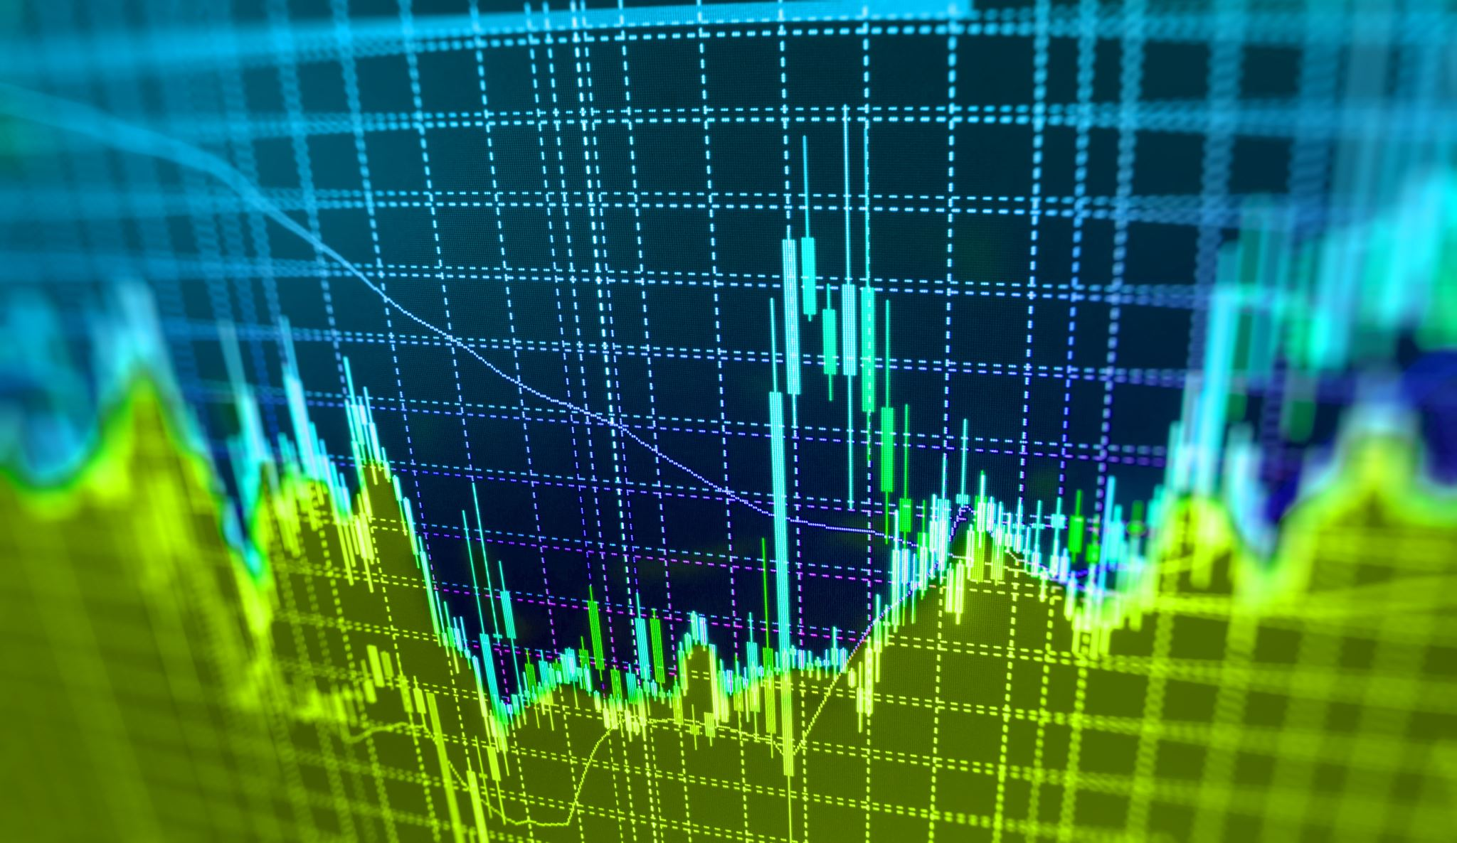
Frequency of Tweeting

Slide 36
How often did they tweet?
The frequency of tweets did not remain the same over the time period
1
The frequency of tweeting was more than 800 tweets halfway through the timeframe
2
There were two dips in in the timeframe – right after beginning, after the first few days of voting and towards the end
3
There was a drastic fall in the number of tweets and even went down to almost 300 just before the declaration of results
4
The average number of tweets during the middle were about 600 tweets
5
The number of tweets dropped to 500 on 22nd May
6

Slide 37

Chances of Winning

Slide 38
Analysing Chances of Winning
We analysed each party’s chances of winning leading up to the results
To do this we plotted the probabilities of each party’s winning chances
Coalitions between parties were also taken into consideration and probabilities of winning were plotted
The probability scores were accurate and showed that BJP had a much higher probability of winning compared to other parties
The plot also showed that parties except BJP and Congress barely stood a chance in the Elections

Slide 39
Poisson Distribution
The mean of the scores of each party were found per day
These were again averaged per day, and the corresponding λ calculated
The Poisson Distribution for each party was plotted
The curve resembled the distribution for λ = 1 for all parties
Since the means differ by microscopic values, they aren’t reflected on the plot
However, results of the distribution show that BJP is the clear winner

Slide 40

Emotion Plots

Slide 41
Measuring Moods
We also analysed the emotions and moods associated with every party and state
The tagged NRC Emotion Lexicon dataset was used to do this
This helped us find out what the people felt about the parties and the moods associated with them
The metric provided a certain degree of measure beyond just the positivity and the negativity of the tweet and helped us find out more about what people think

Slide 42
What did people feel?
BJP had more fear, anger and trust associated with it, along with its popularity
The distribution in moods across states was uniform, suggesting that most people felt the same way irrespective of where they stayed
Feelings of disgust and surprise measured lower values compared to anticipation, trust, joy and fear
The positive and negative emotions also matches the popularity scores of each party

Slide 43

Hypothesis Testing and Confidence Intervals

Slide 44
Hypothesis Testing
We performed two hypothesis tests – one on Score and the other on Popularity
The first was an upper tail test to see if the mean score is greater than 25
The latter was a two-tail test to see if the Popularity is not equal to 0.05
In both tests, we used a 95% confidence interval and the null hypothesis was rejected

Slide 45
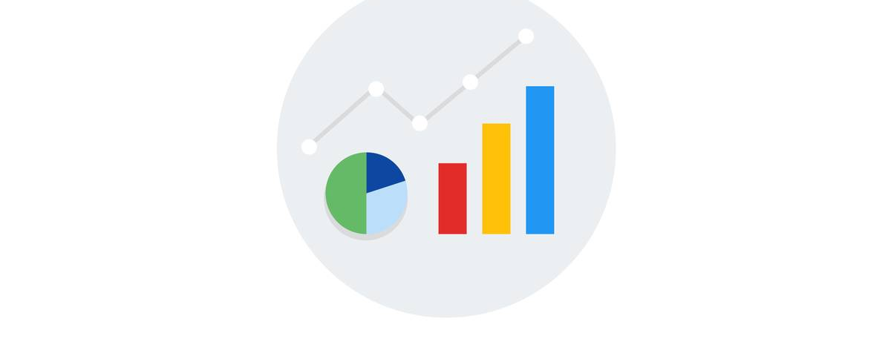
Normal Probability Plot

Slide 46
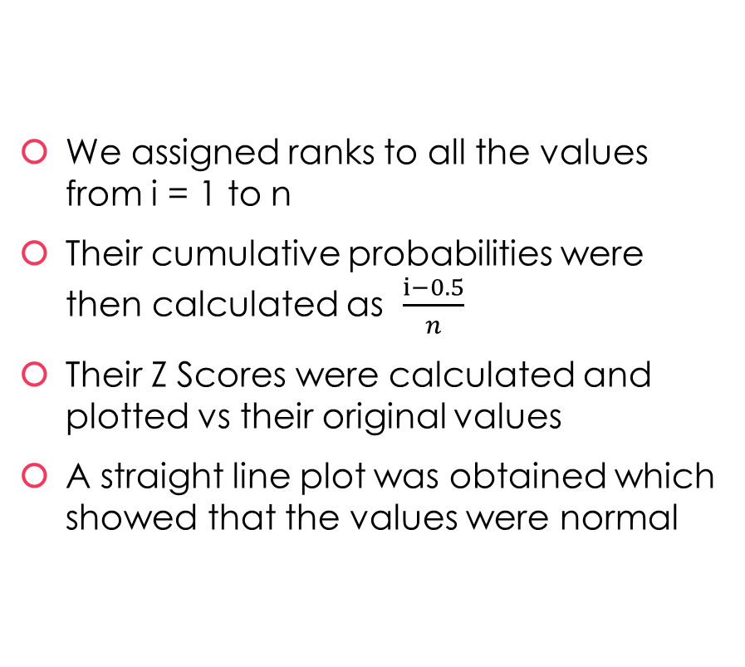
Normal Probability Plot
We assigned ranks to all the values from i = 1 to n
Their cumulative probabilities were then calculated as $\frac{ⅈ−0.5}{n}$
Their Z Scores were calculated and plotted vs their original values
A straight line plot was obtained which showed that the values were normal

Slide 47

Chi Squared Test Statistic

Slide 48
Testing for Chi Square
We use the Chi Square Test to check if two columns are independent
1
It was applied on the sentiment polarity scores – positive, neutral and negative
2
We found the Chi Square to be less than 10%, which hence showed that they are not independent of each other
3
From the Chi Square value we can say that the region isn’t plausible
4

Slide 49
THANK YOU!

